Slide 1
Lemuel Baker, Ph.D
www.lemuelbaker.com

Slide 2
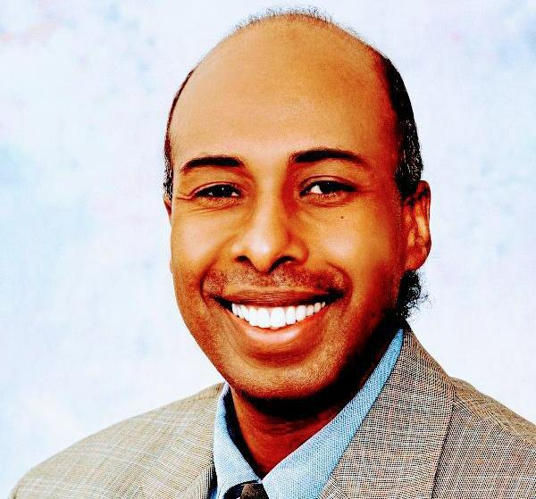

Slide 3
Finance Ministers and Central Bank Governors from the top seven economies

Slide 4
Finance Ministers and Central Bank Governors from the top twenty economies with the highest GDPs

Slide 5
Established on the Kyoto Protocol ratified in Kyoto, Japan in 1997 COP3-Conference of Parties III whereby most industrialized nations and European economies agreed to a general framework and legally binding obligations that included specific targets to reduce carbon emissions of anthropogenic GHGs such as carbon dioxide, methane, nitrous oxide and sulfur.

Slide 6
COP 1, The Berlin Mandate in 1995
COP 2, Geneva, Switzerland 1996
COP 3, The Kyoto Protocol on Climate change in 1997
COP 4, Buenos Aires in 1998
COP 5, Bonn, Germany in 1999
COP 6, The Hague, Netherlands in 2000
COP 6 resumed, Bonn, Germany in 2001

Slide 7
COP 7, Marrakech, Morocco in 2001
COP 8, New Delhi, India in 2002
COP 9, Milan, Italy in 2003
COP 10, Buenos Aires, Argentina in 2004
COP 11, (meeting of the parties) MOP 1, Montreal, Canada in 2005
COP 12, MOP 2, Nairobi, Kenya in 2006
COP 13, MOP 3, Bali, Indonesia in 2007

Slide 8
COP 14, MOP 4, Poznan, Poland in 2008
COP 15, MOP 5, Copenhagen, Denmark in 2009
COP 16, MOP 6, Mexico 2010
COP 17, MOP 7, South Africa scheduled for 2011
COP 18, MOP 8 scheduled for 2012

Slide 9
2013 Update - 19th Session of the Conference of the Parties (COP) to The United Nations Framework Convention on Climate Change (UNFCCC)
2014 Update - UNFCCC COP 20/CMP 10 - Twentieth session of the Conference of the Parties and the tenth session of the Conference of the Parties serving as the meeting of the Parties to the Kyoto Protocol
December 1 - 12, 2014 - Lima, Peru

Slide 10
2015 Update - UNFCCC COP 21/ CMP 11 - Twenty-first session of the Conference of the Parties and the eleventh session of the Conference of the Parties serving as the meeting of the Parties to the Kyoto Protocol
As decided at COP 19, Paris, France
2016 Update - Presidencies event: taking stock of progress made during the Bonn Climate Change Conference – May 26, 2016

Slide 11
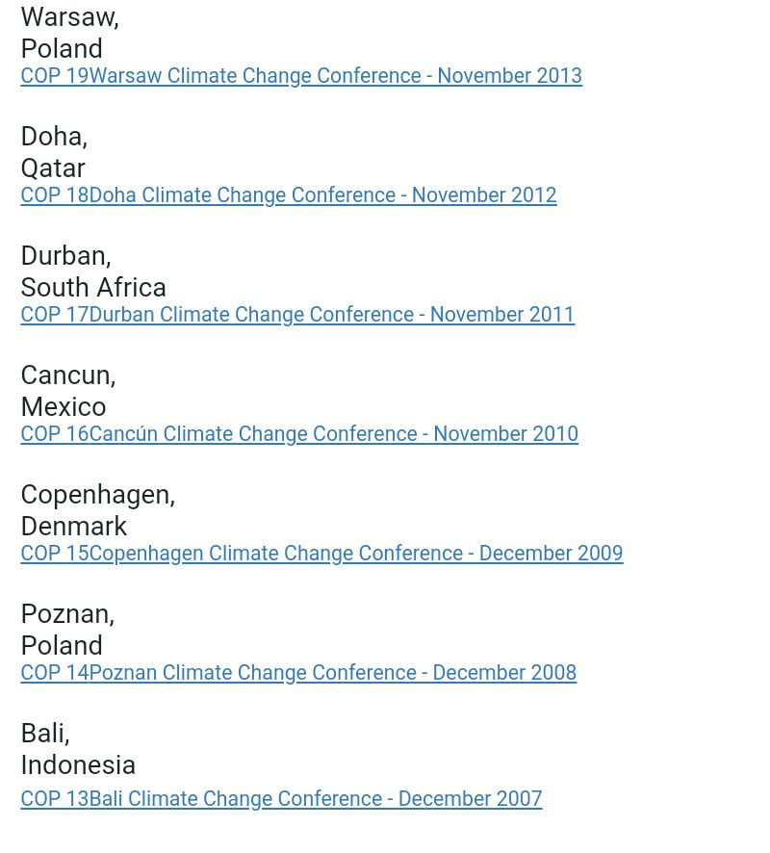

Slide 12
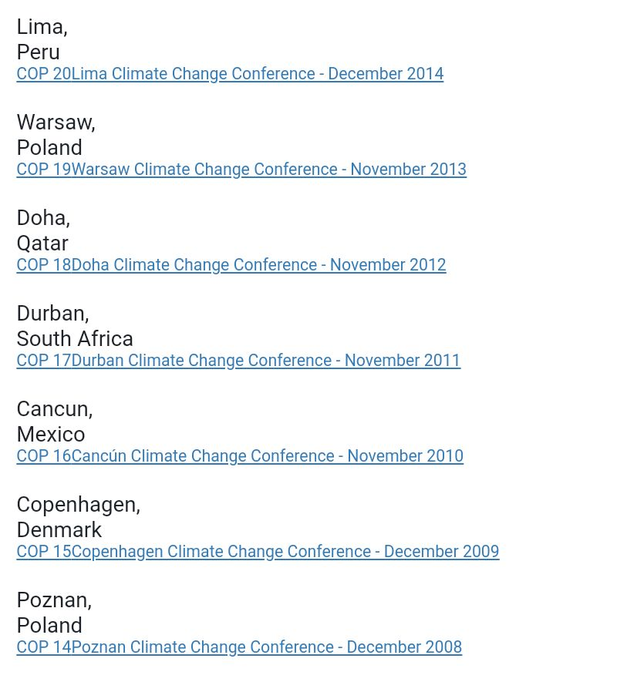

Slide 13
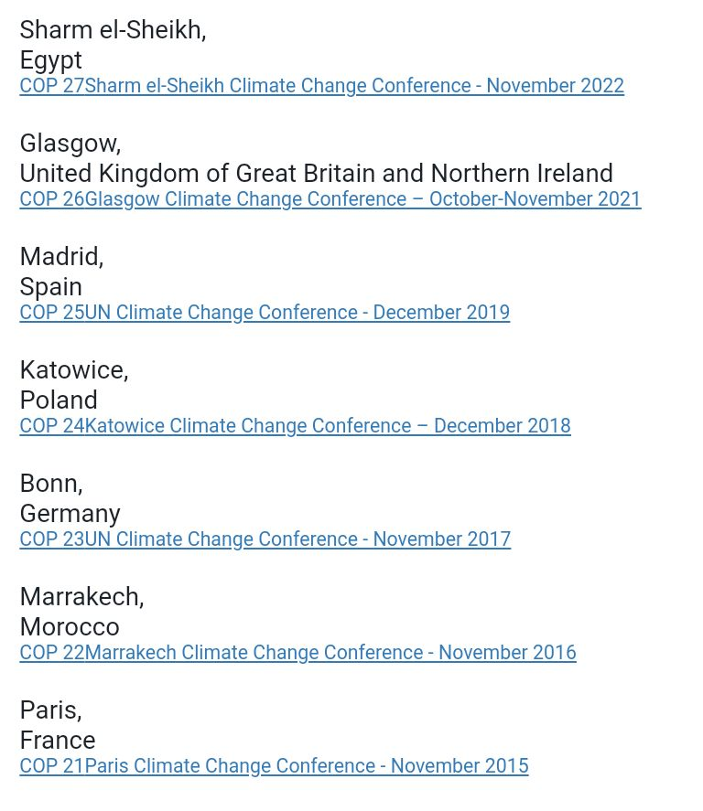

Slide 14
Was distracted by Climate-gate and Climate Justice Protesting

Slide 15
The overall goal for the COP 15/MOP 5 United Nations Climate Change Conference in Denmark was to establish an ambitious global climate agreement for the period from 2012 when the first commitment period under the Kyoto Protocol expires.

Slide 16
"President Obama and other world leaders have decided to put off the difficult task of reaching a climate change agreement... agreeing instead to make it the mission of the Copenhagen conference to reach a less specific “politically binding” agreement that would punt the most difficult issues into the future.

Slide 17
Ministers and officials from 192 countries took part in the Copenhagen meeting and in addition there were participants from a large number of civil society organizations. A large part of the diplomatic work that lays the foundation for a post-Kyoto agreement has been undertaken up to the COP15.

Slide 18
The accord was notable in that it referred to a collective commitment by developed countries for new and additional resources, including forestry and investments through international institutions, that will approach USD 30 billion for the period 2010 - 2012.

Slide 19
The negotiations on extending the Kyoto Protocol had unresolved issues as did the negotiations on a framework for long-term cooperative action. The working groups on these tracks to the negotiations are now due to report to COP 16 and MOP 6 in Mexico.

Slide 20
Climate Justice Protest was to encourage enforcement of climate change laws already in place from the UN Kyoto Conference of December 1-10, 1997 also known as COP 5 held in Kyoto, Japan.

Slide 21
The rich and poor countries at the COP 15 summit were polarized based on poorer countries showing entitlement to funds from richer nations such as the USA and China. There was also temporary walkouts as a result.

Slide 22
This was an exposure by professional hackers of the Climate Research Unit of East Anglia University’s routine and confidential e-mail. East Anglia University is located in eastern England founded in 1962. The actual e-mails were generated by university scientist and staff covering up data that showed the earth cooling instead of warming. The issue is that anthropogenic climate change is a hoax. The e-mails spanned a 13 year period and seem compelling at least on the surface. The e-mails included the phrase “using a trick to hide the decline” as one scientist wrote to another.

Slide 23
Globalization, interdependence of industrialized nations to work together to achieve both political and economic benefit.
Consequently Sustainability has become an agenda item on every desk of every world leader, corporation and household.

Slide 24
Sustainability and “going green” can now be experienced in our grocery stores, retailers, hotels, schools and hospitals.

Slide 25
Sustainability: to use resources to meet the present needs without compromising the ability of future generations to meet their own needs.
Nothing is Wasted.
Using resources at a rate that can be replenished.
Sustainable development does not only focus on environmental issues.

Slide 26
Economic Pillar: preserving financing so that future generations may be provided for.
Social Pillar: preserving acceptable behavior to influence future generations.
Environmental Pillar: ensuring our interaction with the environment is pursued with preserving the environment in mind. “Going Green” an off-shoot of the Environment Pillar.

Slide 27
REDUCE: choose processes that reduce chemical usage that can be introduced into our environment. Less packaging, bulk purchasing.
REUSE: choose products that may be reused rather than one-time usage items. End single use devices go for reusable devices.
RECYCLE: find and identify recycle partners. Select products that can be recycled.

Slide 28
Recycling is also a revenue stream:
Agriculture produces methane as a result of fermentation as a GHG.
Organic materials emit GHG as they decay.
Thus turning them into a revenue stream saves our environment but also creates a revenue stream.
“What is the purpose of a sawmill without the trees.”

Slide 29
Rice Bran that rots quickly when separated from the kernel is converted to a meat preserver by Nutracea, Phoenix, AZ
Cranberry Seeds added to food and beverage products after converted a powder form. AHD Atlanta based.
Eggshell membranes converted to eggshell calcium to enhance bone joint health.
ESM Technologies, Missouri.

Slide 30
Olive Mill Waste: olives are 20% oil and 50% water thus the water putrefies as waste and turns to methane GHG. The water is freeze dried to powder then added to pasta, mayonnaise and beverages.
Grape Seeds: The company Polyphenolics works with GNC and Melaleuca to produce and market grape seed extract to turning grape seeds and skin into potable minerals.
Cardboard recycled for reuse.

Slide 31
Plastic bottles from soda and bottled water recycled into fabric and used to make professional clothing line such as dress slacks and jackets.
Instead of plastic bottles going to the waste they are segregated, processed and turned into a profit stream.

Slide 32
Definition: Reducing waste at the point of origination by analyzing current processes and making process changes or using less toxic chemicals.
Reusing materials rather than sending them into waste streams.
Reducing pollution from the source.

Slide 33
Human activities have an impact on the levels of GHG.
Anthropogenic GHG or man made GHG are linked to the increase of GHG in the earth’s atmosphere such as:
Refrigerants
Solvents
CFCs chlorofluorocarbons such as Freon.

Slide 34
Water Vapor: evaporated water causes 36-70% GHG on the earth.
Carbon Dioxide: 26% of GHG by product of respiration used by plants for photosynthesis. Also produced by burning fossil fuels.
Methane: 95% of GHG by live stock enteric fermentation.
Nitrous Oxide: 3-7% GHG laughing gas, also used as air propellant for aerosol whipped cream, cooking sprays and in packages of potato chips.

Slide 35
Natural GHG are water vapor and carbon dioxide.
Anthropogenic GHG are man made GHG produced by technology and are of the most concern requiring oversight.

Slide 36
Anthropogenic by definition is as follows:
From Koine Greek words “Anthropos” which means “man” and “Genesis” which means “to create.”
Anthropogenic by definition means “man made or created by man.”
Historical Oil Spills
Terrorism related to biological and atomic warfare.
Atomic blasts produce radiation that has a half life of 30 years or more. A blast could make your city uninhabitable for 30 years or more.

Slide 37
Amoco Cadiz, France, March 16, 1978-68.7 million gallons
Arabian Gulf Spill, 1991 Gulf War, Kuwaiti tankers and terminals destroyed-252-336 million gallons
Argo Merchant Ship, December 15, 1976, Nantucket Massachusetts- 7.7 million gallons
Barge Bouchard August 10, 1993, Tampa Bay Florida-336,000 gallons
Barge Cibro Savannah, linden New Jersey, March 6, 1990-127,000 gallons

Slide 38
Burma Agate, Galveston Texas, November 1, 1979-2.6 million gallons
Exxon Valdez, Prince William Sound Alaska, March 24, 1989-10.3 million gallons
Ixtoc I, Ciudad del Carmen Mexico, 2-mile deep exploratory well, March 1980-140 million gallons
Jupiter Oil Ship, Saginaw River Michigan, September 16, 1990-no record of gallons spilled after explosion.
Megaborg vessel, Galveston, Texas, June 8, 1990-5.1 million gallons

Slide 39
Gulf Coast BP-Deep Water Horizon Platform Spill affecting Louisiana, and all gulf coast states, April 2010 spilled 4.5 mil barrels or 184-189 mil gallons given 1 barrel= 42 gals
Contaminants coating the ocean floor due to dispersants used
Dispersants could be harmful to the eco-system
THIS MAN-MADE INCIDENT COULD HAVE BEEN AVOIDED.
Anthropogenic GHG are of the most concern rather than natural GHG
China oil spill, July 2010, sticky as tar, 165 square miles

Slide 40
Ozone: 3-7% air pollutant and harmful to the respiratory track. In the upper atmosphere ozone filters damaging ultra violet light from reaching the earth. Low level Ozone is produced by car engines and industrial machinery.
CFCs: Chlorofluorocarbons
Developed in the early 1930s
Polar Ozone depletion over Antarctica.
Ozone depletion potential ODP

Slide 41
Definition: The total set of Green House Gases (GHG) emitted directly and sometimes indirectly from an
INDIVIDUAL
ORGANIZATION
EVENT
PRODUCT

Slide 42
Definition: Is the total set of green house gases GHG emitted by an individual, organization, event or product. (UK Carbon Trust 2008.)
UK Study by Gary Hag et. al., 2007 with the Stockholm Environment Institute found on average that carbon foot prints for individuals are higher for the demographics of ages 50-65 registering at 13.5 tonnes/capita.

Slide 43
Events/Holidays: Olympics Held every four years has it’s own carbon foot print.
Corporations especially with a large employee base have their own carbon footprint. New Years, 4th of July etc.
Products have their own carbon footprint.
Countries and Nations have their own carbon footprint.
Individual households have their own carbon footprint.

Slide 46
Countries with the largest carbon footprints are:
China
USA
South Korea
Singapore
India

Slide 47
City with the largest carbon footprints are:
Linfen, China due to coal and particulates.
Literally hard to breath
Upper respiratory track noticeably affected
Rationale by indigenous people in Linfen is we have jobs, food and can trade off for our health.

Slide 48
Definition: A measure of how much a green house gas could contribute to global warming.
Global warming is affected by a gases atmospheric lifetime.
Molecules may be highly destructive to the atmosphere short term while molecules with longer life spans destroy the atmosphere at a slower rate.

Slide 49
The average time for any molecule to stay in the atmosphere before being removed by mixing into the ocean or by photosynthesis.
Carbon Dioxide: lifetime cannot be specified and has GWP of one.
Methane: lifetime of 12 +/-3 years and GWP of 72.
Nitrous Oxide: life time 114 years and GWP 289.
CFCs: vary in lifetimes from 12-50,000 years GWP 5,160-15,000 (very high).

Slide 50
Definition: The increase of the earth’s temperature near surface air and over oceans since the mid-1900s and the projections that it will continue.
Causes of increased greenhouse gases.
Human activity-increased population-6.8 billion projected to reach 9.3 billion in 2050.
Fossil fuel burning.
Deforestation.
Pre-industrial volcanic eruptions.
WARS ????

Slide 51
Definition: The rate at which our population consumes resources given population numbers, levels of consumption and the impact caused by technology.
Human Impact Equation: Population (P) x Level of Consumption (L) x Technological usage (T) = Environmental Impact (E).
E=P x L x T
The Environmental Impact can be estimated for any country, organization or household.

Slide 52
Choices: Starting with individual life styles.
Spending patterns
Selection of sustainable goods and services.
Analysis of individual and corporate consumption of goods and services.
Consider how the 3-pillars of sustainability are working in harmony together.

Slide 53
Definition: To cap how much carbon dioxide any company may generate.
Charge companies for every portion of CO2 released into atmosphere.
Controversial aspect of “cap and trade” is low generators may sell credits to high generators of CO2 (trade) who have released past the capped amount for their company.
High generators may continue to generate large amounts of CO2 side tracking system.

Slide 54
This is the meteorological Organization of the United Nations.
Controversy is the IPCC uses scientific information provided by the CRU, The Climate Research Unit of East Anglia University as well as scientific information from Penn State Earth System Science Center to form UN policy on Climate Change.
Errors have been identified in the data reported by both climate data authorities.

Slide 55
The CRU data in conjunction with data from the Penn State Earth System Climate Center both eliminated the data showing the earth’s temperature increasing noticeably from 1000 CE to 1300 CE then decreasing and from 1300 CE to 1900 CE then increasing again .
Comprehensive data on climate change shows earth has gone through cooling and warming periods not just a chronic increase of temperature.

Slide 56
History: On January24, 2007 Bush 43 signed this executive order. This order included goals such as toxic reductions, sustainable buildings and recycling for all government agencies.
The data obtained from this executive level office is also available as benchmarks.

Slide 57
Estimation of waste generated by OFEE can also help estimate environmental impact for smaller settings such as our home, our individual departments, an entire building or a group of buildings.
To estimate a buildings annual waste stream the following formula is used:
# of employees x 1.6 lbs/day x 250 days/yr
2000
OFEE deducted all weekends and 11 holidays and estimated each person generates 1.6 lbs per day on average. Dividing by 2,000 converts lbs. to tons.

Slide 58
Checks and Balances of “Going Green”:
Are the 3-pillars of sustainability working together?
Are the green products selected draining your budget? (Financial Pillar)
Are the end users edified by your product selection? (Social Pillar)
Are the selected products actually decomposing at the landfill as claimed? (Environmental Pillar)

Slide 59
Proponents of Sustainable Development argue that cutting edge “green development” is unattainable.
Example is a cutting edge “green” treatment plant with extremely high maintenance costs may not be sustainable in regions of the world and in marginal local economies with fewer financial resources.

Slide 60
A green environmentally ideal plant that is too costly resulting in the plant having to shut down and increases unemployment is not a sustainable approach because the environmental pillar jeopardizes the financial and social pillars from functioning. Sustainability must respect the functions of all 3 pillars.

Slide 61
Proponents of sustainability also specify that “going green” prioritizes environment sustainability or focuses on the environment pillar disregarding economic an social considerations.
True sustainability must allow all three pillars of sustainability to interact and form interdependence.

Slide 62
When making decisions regarding sustainability try to use measurable indicators, metrics and benchmarks already built into your internal systems.
The cost effectiveness to “go green” for developing countries or small corporations may literally put them out of business.
Small countries or corporations may not be able to afford the products and technology needed to go green.

Slide 63
Thus a modified and incremental implementation may be necessary.
Going green should not break the bank because then it defies the concept of sustainability.
Design an action plan.
Take tiny steps towards sustainability.

Slide 64
Risk Management assessment before making a decision to stop development that produces GHG.
To stop development of special pharmaceuticals for example may prevent the cure for major diseases.
Decide to develop pharmaceutical and manage GHG and carbon foot print while in production.

Slide 65
Interventions are needed.
According to Nathan Myhrvold an intellectual genius, formerly chief technology officer for Microsoft, began college at age 14 and obtained his PhD at age 23 agrees we need a…
Backup plan B
Blocking sunlight at the north and south poles to cool the earth for example.

Slide 66
Because anthropogenic GHGs linger in the air for sometimes hundreds of years even though we begin to reduce emissions there will still be GHGs remaining in the air for years that were produced decades before which have not been absorbed by trees or by the oceans.

Slide 67
QUESTIONS?

